Slide 1

Crop Production Analysis in India

Slide 2
Introduction
Problem statement:
Agriculture plays a vital role in sustaining global food security and economic development. However, optimizing crop production remains a complex challenge due to various environmental factors and uncertainties.
The analysis of crop production data is crucial for understanding agricultural trends, optimizing resource allocation, and informing policy decisions to enhance productivity and sustainability

Slide 3
Goals and objective
The primary goal is to analyze the relationship between crop and production and key environmental factors using machine learning.
Specific objectives include:
Building predictive models to forecast crop yields based on historical data.
Identifying key factors that influence crop production variability.
Providing actionable insights to stakeholders in the agricultural sector to optimize resource management and enhance productivity.

Slide 4
Data Exploration
Exploratory Data Analysis (EDA)
Dataset Overview
Correlations Analysis
Briefly describe the structure of the dataset, including the number of records and features.
Mention the types of information included in the dataset, such as crop types, crop years, geographical locations, and environmental factors.
Present key insights obtained from exploratory data analysis using visualizations.
Scatter plots: Visualize the relationship between crop production and environmental factors like rainfall and temperature.
Histograms: Show the distribution of crop production values across different crop types or years..
Highlight correlations between crop production and environmental factors such as rainfall, temperature, soil quality, etc.
Use correlation matrices or correlation heatmaps to visualize the strength and direction of these relationships.

Slide 5
Model development
Machine Learning Models
Feature Selection
Model Training & Evaluation
Linear Regression: A simple and interpretable model that assumes a linear relationship between the input features and the target variable.
Random Forest Regression: A versatile ensemble learning method that uses multiple decision trees to make predictions, suitable for capturing nonlinear relationships and handling complex datasets.
Describe the feature selection process and any feature engineering techniques applied to improve model performance.
Identifying and removing irrelevant or redundant features.
Creating new features through transformations, scaling, or encoding categorical variables.
Handling missing values using techniques such as imputation or deletion.
Detail the model training procedure, including the splitting of the dataset into training and testing sets.
Explain how each model was trained using the training data.
Describe the evaluation metrics used to assess model performance, such as Mean Absolute Error (MAE), Mean Squared Error (MSE), and R-squared (R2) score.

Slide 6
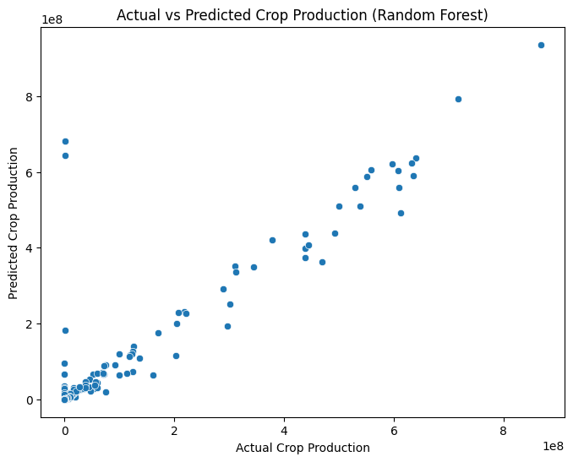
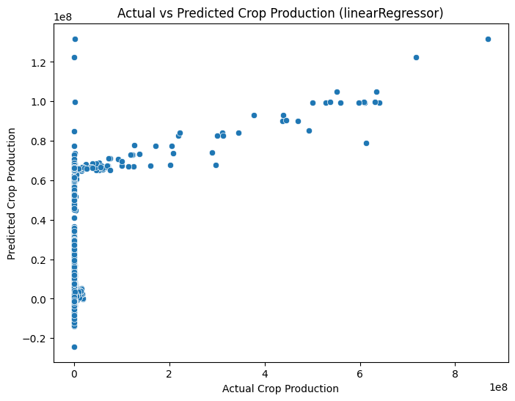
Results and Comparison:
Random forest
Linear regression

Slide 7
Conclusion:
Discrepancy Between Actual and Predicted Production:
Despite our efforts in building predictive models using Linear Regression and Random Forest Regression, the actual production consistently exceeds the predicted production across both models.
This discrepancy is evident in the higher values of Mean Absolute Error (MAE) and Mean Squared Error (MSE) observed for both models.
The findings highlight the challenges in accurately predicting crop production using the current modeling approaches.
Future Directions:
Future research could focus on improving model performance by incorporating additional features, utilizing more advanced machine learning algorithms, and exploring ensemble methods to combine multiple models for enhanced accuracy.

Slide 8
Thank you

